Slide 1
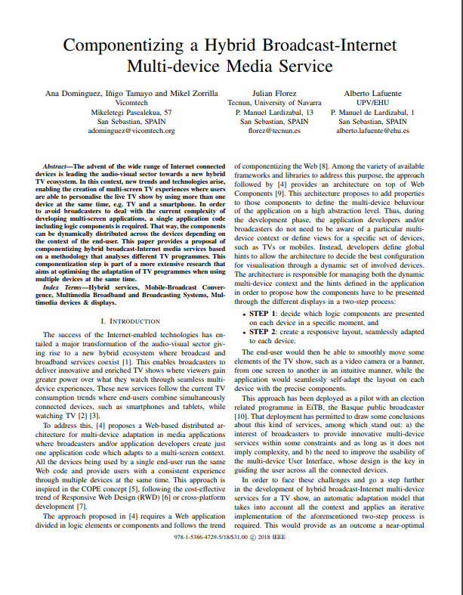
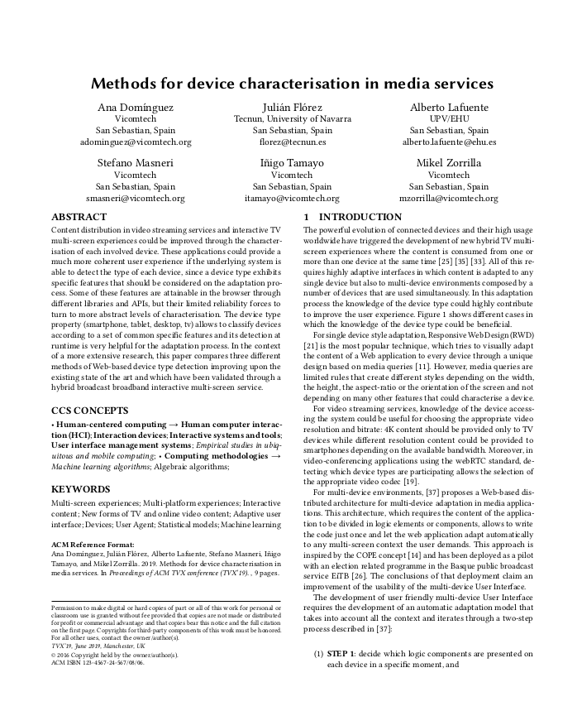
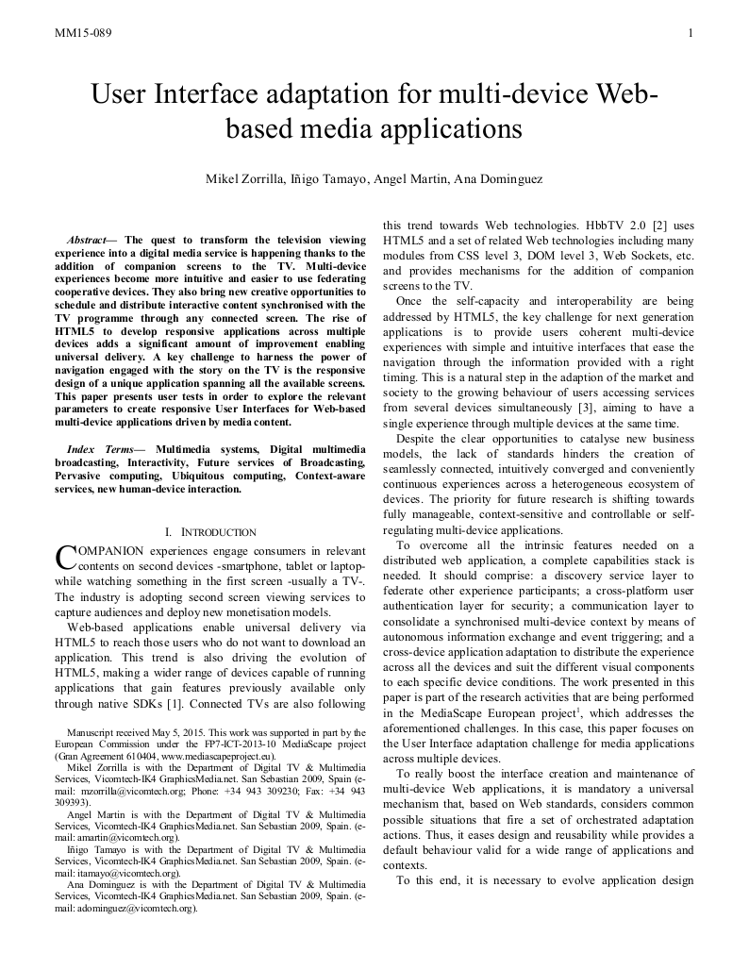
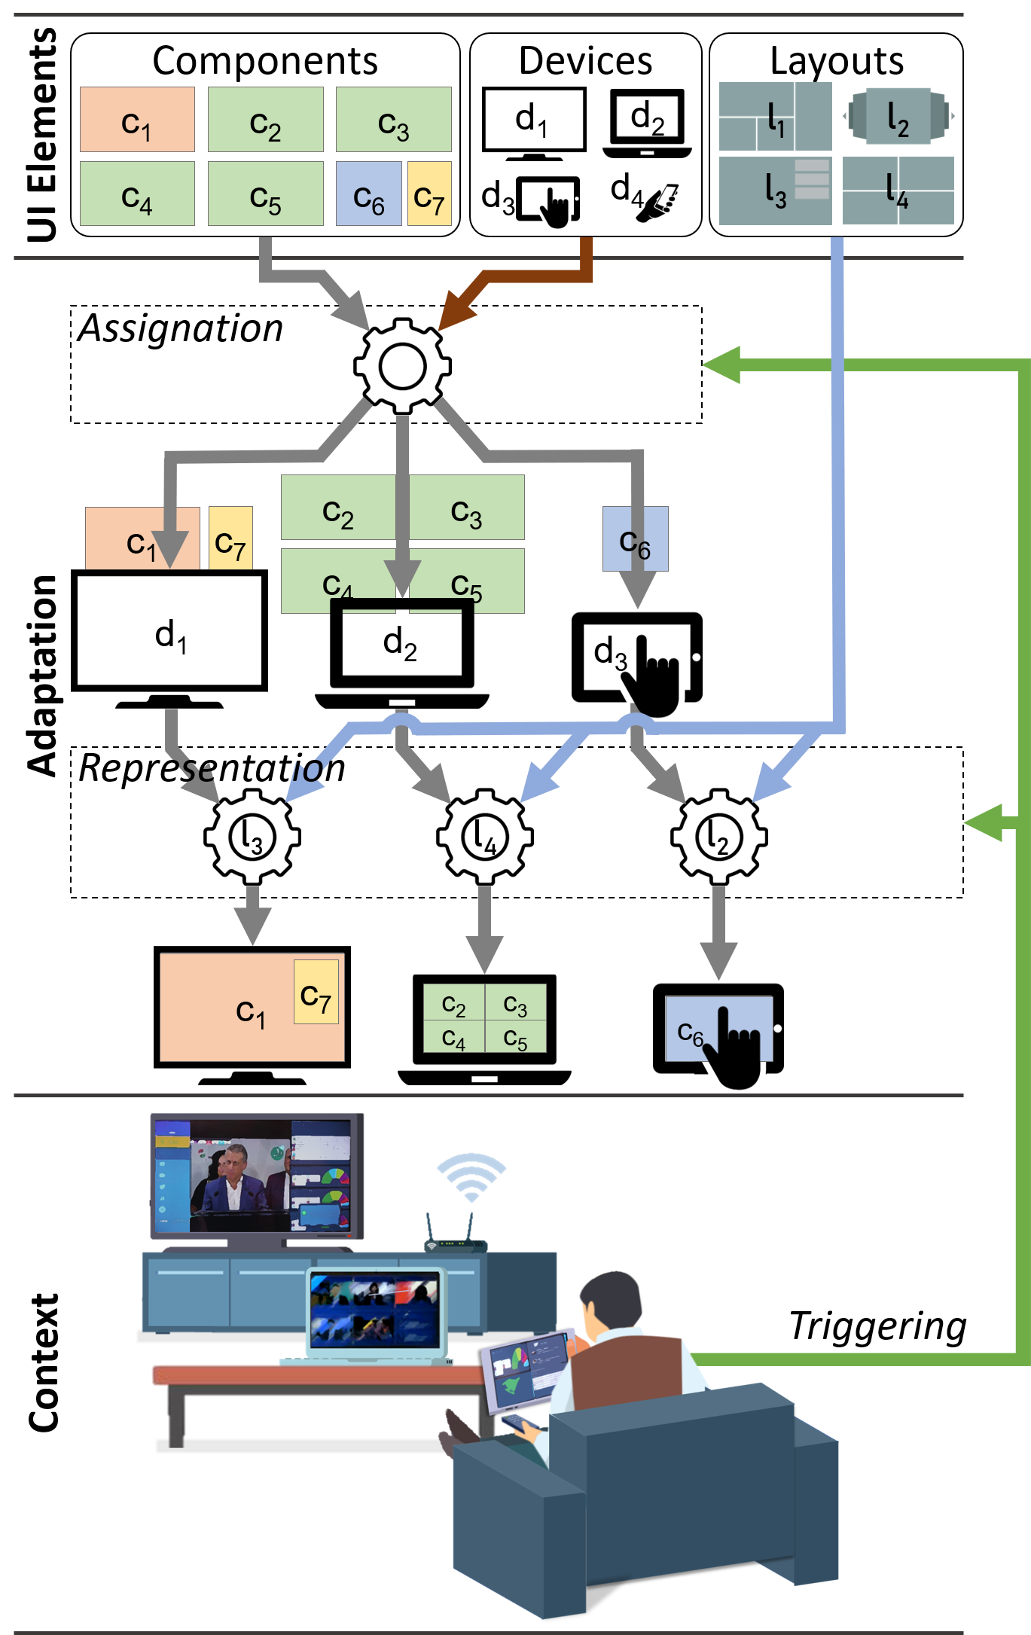
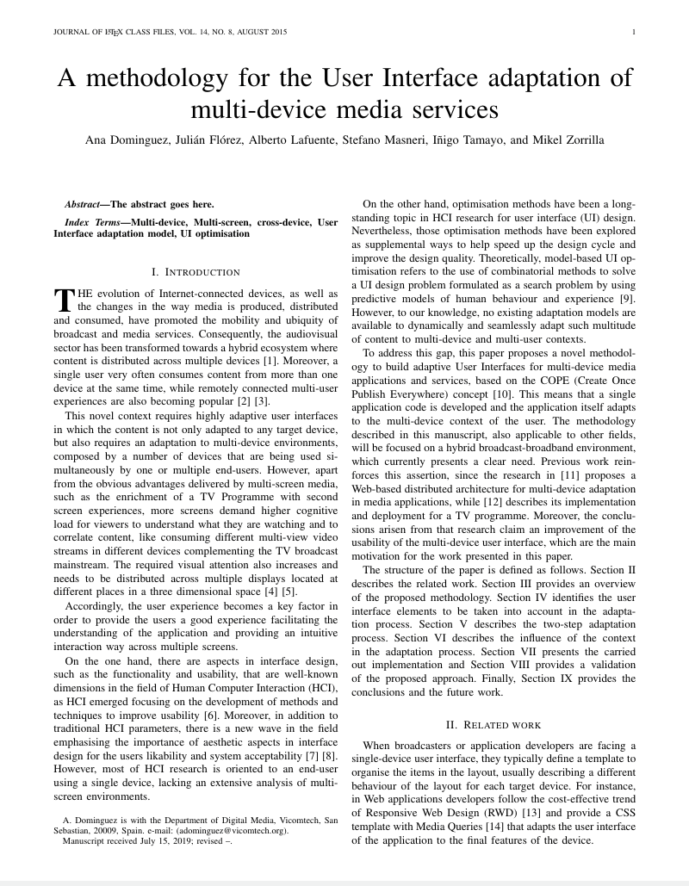
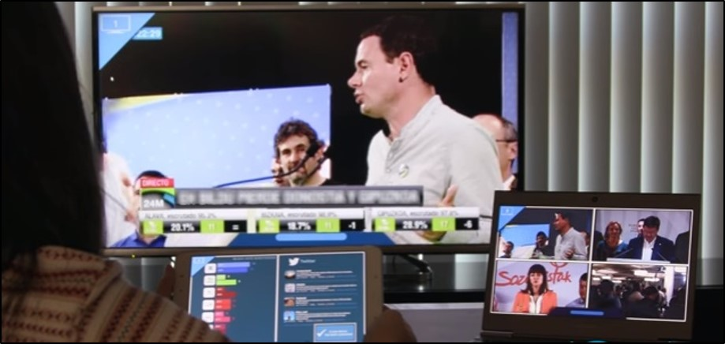
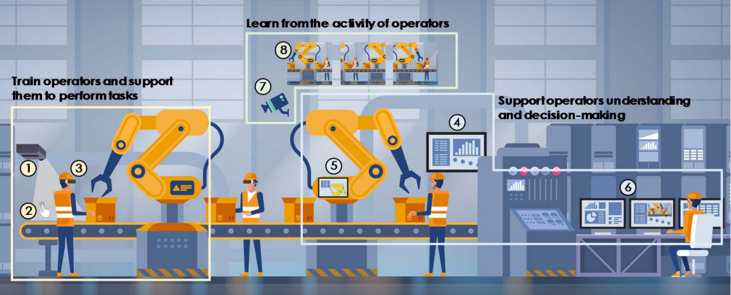
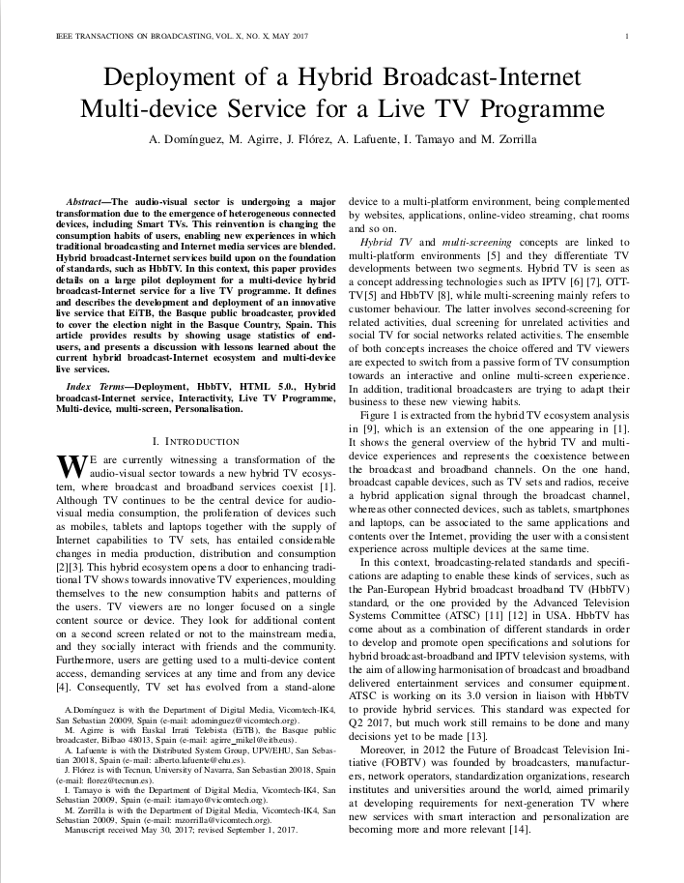
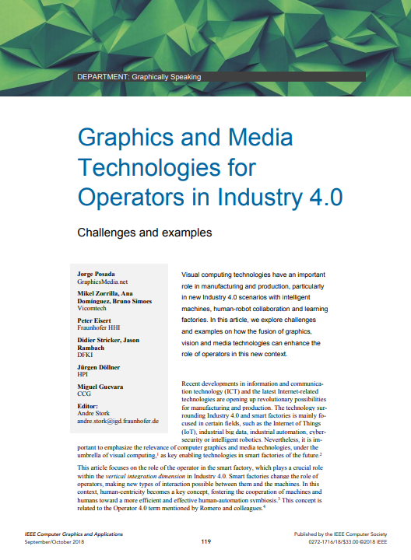
UI ELEMENTS CHARACTERISATION
2
Dominguez, A., Tamayo, I., Zorrilla, M., Florez, J., & Lafuente, A. (2018, June). Componentizing a Hybrid Broadcast-Internet Multi-Device Media Service. In 2018 IEEE International Symposium on Broadband Multimedia Systems and Broadcasting (BMSB) (pp. 1-6). IEEE.
3
4
Dominguez, A., Florez, J., Lafuente, A., Masneri, S., Tamayo, I., & Zorrilla, M. (2019, June). Methods for device characterisation in media services. In Proceedings of the 2019 ACM International Conference on Interactive Experiences for TV and Online Video (pp. 118-128). ACM.
Zorrilla, M., Tamayo, I., Martin, A., & Dominguez, A. (2015, June). User interface adaptation for multi-device Web-based media applications. In 2015 IEEE International Symposium on Broadband Multimedia Systems and Broadcasting (pp. 1-7). IEEE.
Learned lessons
MULTI DEVICE USER INTERFACE ADAPTATION
Starting Point
DEPLOYMENT
5
APPLICATIONS
Broadcast-Internet Multi-device experience
Broadcast Industry Safety
Technologies for Interoperable multi-device media services
(Mikel's Thesis)
Pilot
1
Learned lessons
Submitted 2019
1
Dominguez, A., Agirre, M., Flörez, J., Lafuente, A., Tamayo, I., & Zorrilla, M. (2017). Deployment of a hybrid broadcast-Internet multi-device service for a live TV programme. IEEE Transactions on Broadcasting, 64(1), 153-163.
Extensible
6
Posada, J., Zorrilla, M., Dominguez, A., Simoes, B., Eisert, P., Stricker, D., ... & Guevara, M. (2018). Graphics and Media Technologies for Operators in Industry 4.0. IEEE computer graphics and applications, 38(5), 119-132.
FUTURE WORK
Context characterisation
Automatic learning
Other?

Slide 2
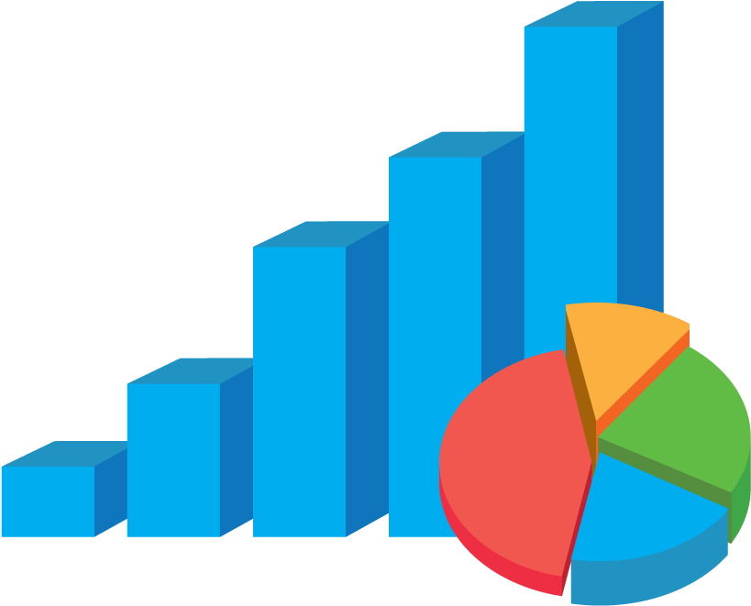
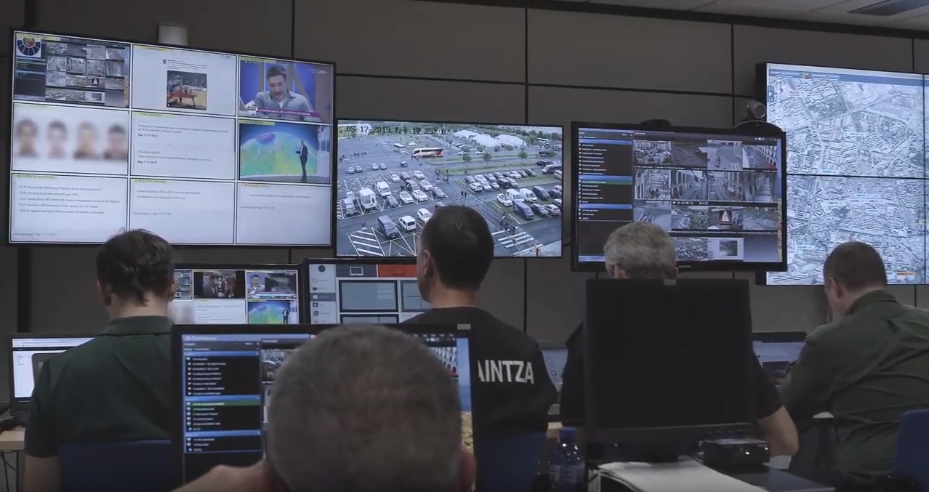


Obj. 2
MULTI DEVICE USER INTERFACE ADAPTATION
Obj. 1
DEPLOYMENT
Contr. 2
Contr. 3
Contr. 4
Obj. 3
FIELDS OF APPLICATION
Contr. 1
Large scale pilot of a broadcast-Internet Multi-device service for a live TV programme
Contr. 6
Learned lessons
Extensible
Usage statistics
Contr. 5
Obj. 4
READY FOR CONTINUOUS ADAPTIVE LEARNING PROCESSES
Extensible

Slide 3
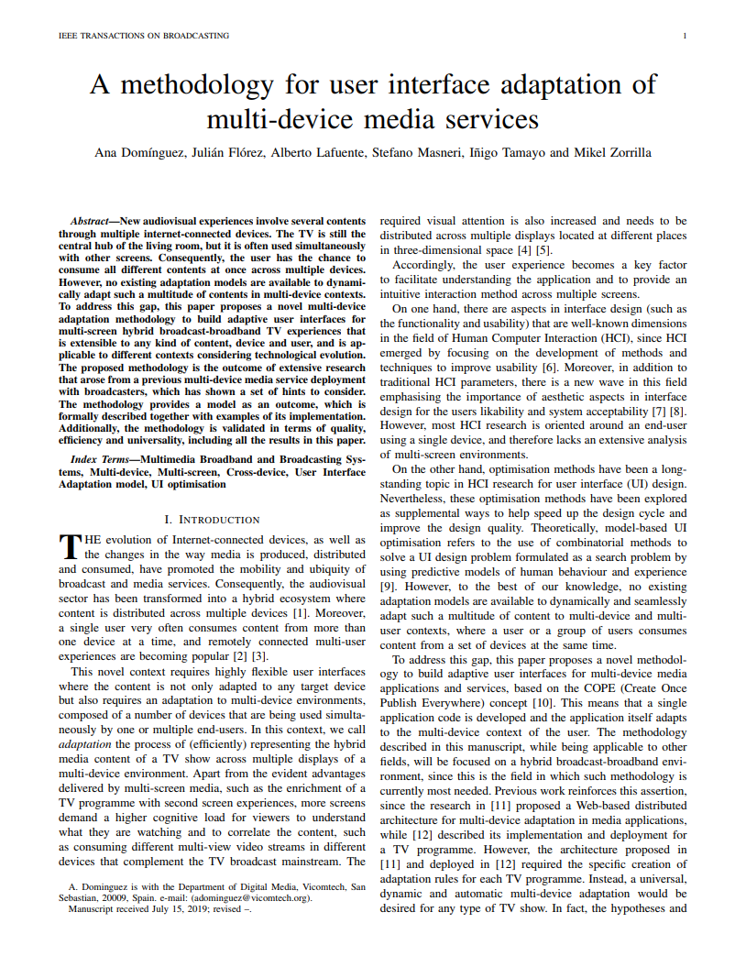
Obj. 2
MULTI DEVICE USER INTERFACE ADAPTATION
UI elements characterization
Contr. 2
Contr. 3
Contr. 4
Obj. 3
FIELDS OF APPLICATION
Industry 4.0
Obj. 1
DEPLOYMENT
Dominguez, A., Tamayo, I., Zorrilla, M., Florez, J., & Lafuente, A. (2018, June). Componentizing a Hybrid Broadcast-Internet Multi-Device Media Service. In 2018 IEEE International Symposium on Broadband Multimedia Systems and Broadcasting (BMSB) (pp. 1-6). IEEE.
Dominguez, A., Florez, J., Lafuente, A., Masneri, S., Tamayo, I., & Zorrilla, M. (2019, June). Methods for device characterisation in media services. In Proceedings of the 2019 ACM International Conference on Interactive Experiences for TV and Online Video (pp. 118-128). ACM.
Zorrilla, M., Tamayo, I., Martin, A., & Dominguez, A. (2015, June). User interface adaptation for multi-device Web-based media applications. In 2015 IEEE International Symposium on Broadband Multimedia Systems and Broadcasting (pp. 1-7). IEEE.
Contr. 6
Large scale pilot of a broadcast-Internet Multi-device service for a live TV programme
Contr. 1
Posada, J., Zorrilla, M., Dominguez, A., Simoes, B., Eisert, P., Stricker, D., ... & Guevara, M. (2018). Graphics and Media Technologies for Operators in Industry 4.0. IEEE computer graphics and applications, 38(5), 119-132.
Learned lessons
Adaptation model
Extensible
Contr. 5
Dominguez, A., Florez, J., Lafuente, A., Masneri, S., Tamayo, I., \& Zorrilla, M. (Submitted in 2019, November). A methodology for user interface adaptation of multi-device media services. IEEE Transactions on Broadcasting
Dominguez, A., Agirre, M., Flörez, J., Lafuente, A., Tamayo, I., & Zorrilla, M. (2017). Deployment of a hybrid broadcast-Internet multi-device service for a live TV programme. IEEE Transactions on Broadcasting, 64(1), 153-163.
Obj. 4
READY FOR CONTINUOUS ADAPTIVE LEARNING PROCESSES
Extensible

Slide 4
Obj. 2
MULTI DEVICE USER INTERFACE ADAPTATION
UI elements characterization
Contr. 2
Contr. 2
Contr. 2
Contr. 2
Dominguez, A., Tamayo, I., Zorrilla, M., Florez, J., & Lafuente, A. (2018, June). Componentizing a Hybrid Broadcast-Internet Multi-Device Media Service. In 2018 IEEE International Symposium on Broadband Multimedia Systems and Broadcasting (BMSB) (pp. 1-6). IEEE.
Contr. 2
Contr. 3
Dominguez, A., Florez, J., Lafuente, A., Masneri, S., Tamayo, I., & Zorrilla, M. (2019, June). Methods for device characterisation in media services. In Proceedings of the 2019 ACM International Conference on Interactive Experiences for TV and Online Video (pp. 118-128). ACM.
Contr. 3
Contr. 3
Obj. 3
FIELDS OF APPLICATION
Contr. 4
Zorrilla, M., Tamayo, I., Martin, A., & Dominguez, A. (2015, June). User interface adaptation for multi-device Web-based media applications. In 2015 IEEE International Symposium on Broadband Multimedia Systems and Broadcasting (pp. 1-7). IEEE.
Industry 4.0
Obj. 1
DEPLOYMENT
Contr. 6
Contr. 6
Large scale pilot of a broadcast-Internet Multi-device service for a live TV programme
Contr. 1
Learned lessons
Adaptation model
Extensible
Posada, J., Zorrilla, M., Dominguez, A., Simoes, B., Eisert, P., Stricker, D., ... & Guevara, M. (2018). Graphics and Media Technologies for Operators in Industry 4.0. IEEE computer graphics and applications, 38(5), 119-132.
Contr. 5
Posada, J., Zorrilla, M., Dominguez, A., Simoes, B., Eisert, P., Stricker, D., ... & Guevara, M. (2018). Graphics and Media Technologies for Operators in Industry 4.0. IEEE computer graphics and applications, 38(5), 119-132.
Dominguez, A., Florez, J., Lafuente, A., Masneri, S., Tamayo, I., \& Zorrilla, M. (Submitted in 2019, November). A methodology for user interface adaptation of multi-device media services. IEEE Transactions on Broadcasting
Dominguez, A., Agirre, M., Flörez, J., Lafuente, A., Tamayo, I., & Zorrilla, M. (2017). Deployment of a hybrid broadcast-Internet multi-device service for a live TV programme. IEEE Transactions on Broadcasting, 64(1), 153-163.
Obj. 4
READY FOR CONTINUOUS ADAPTIVE LEARNING PROCESSES
Extensible

Slide 5

IMPLEMENTATION
VALIDATION
EVALUATION
MODELLING
HYPOTHESIS
DESIGN
LESSONS LEARNED
METHODOLOGY
CONTRIBUTIONS

Slide 6
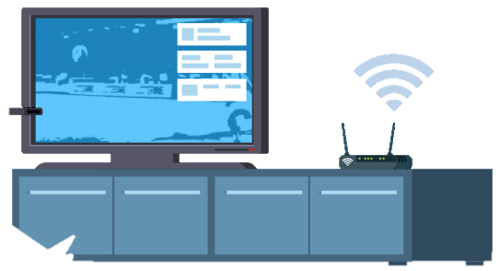
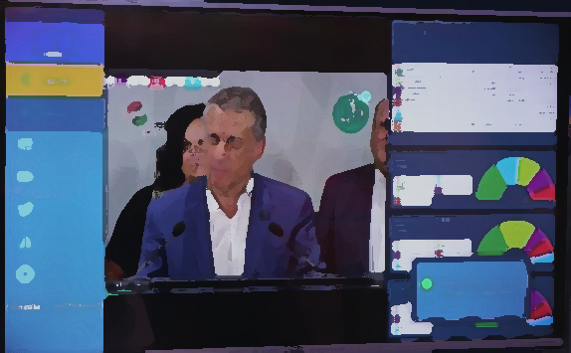
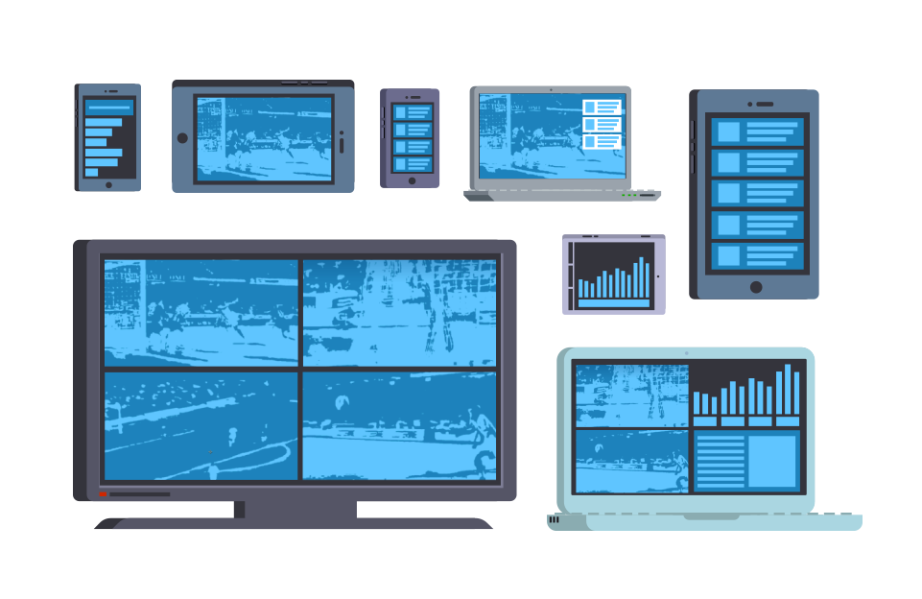
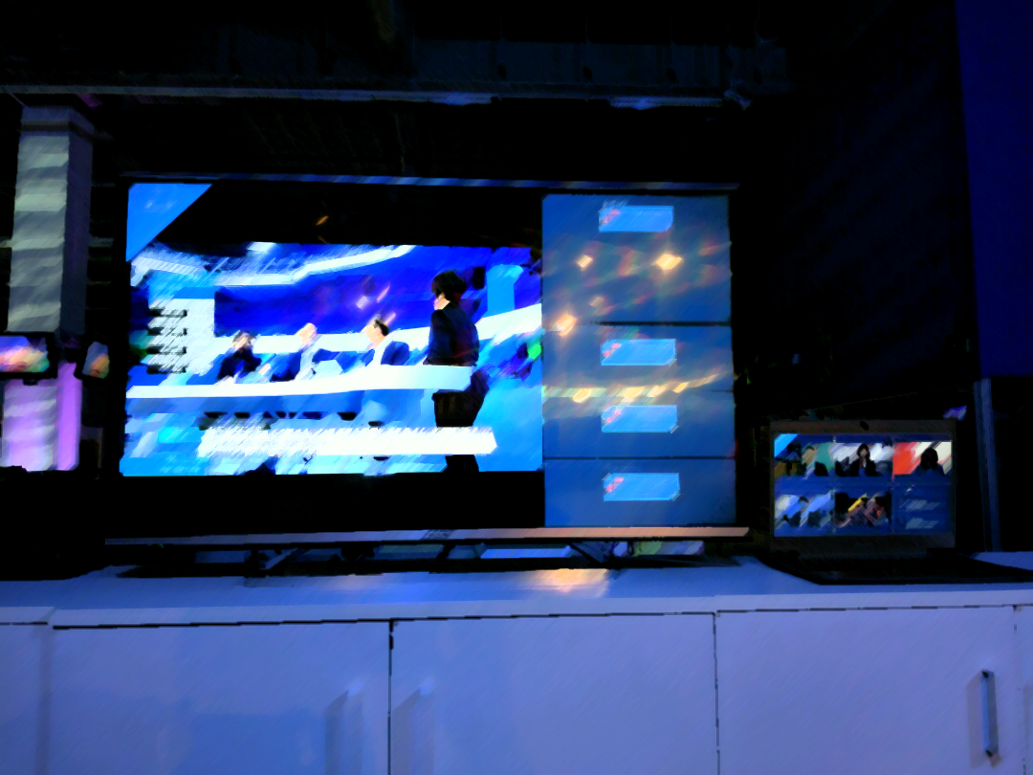
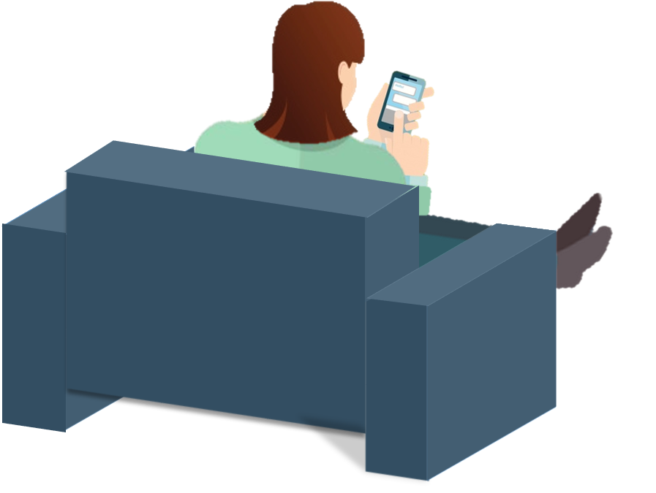


Slide 7
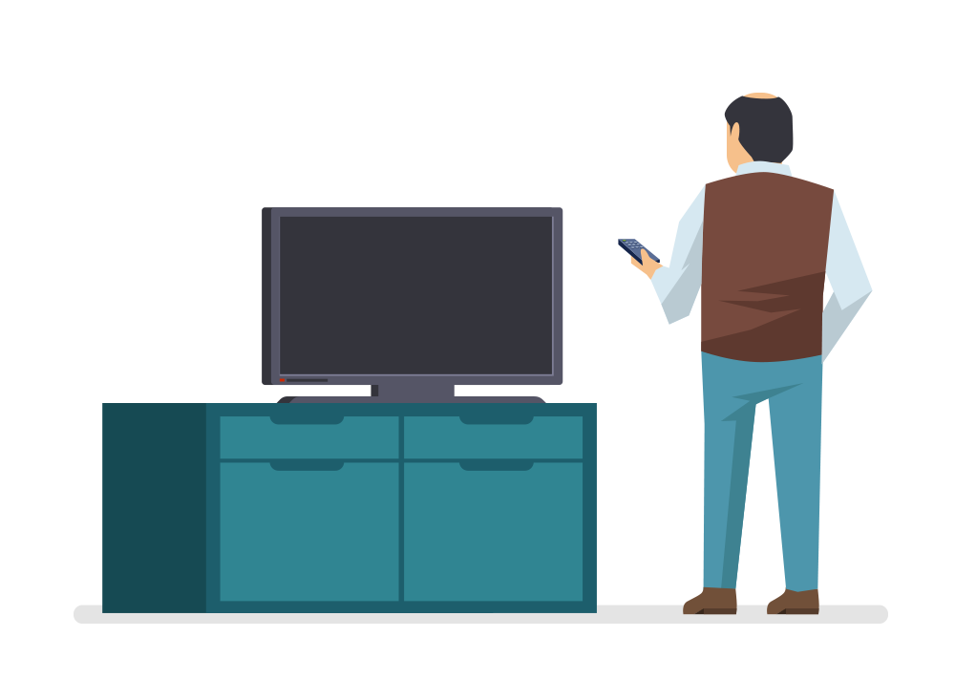
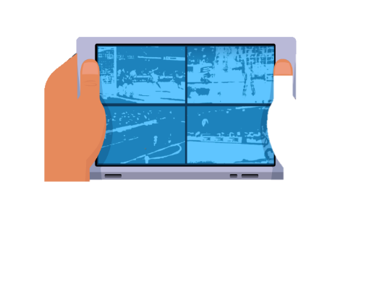

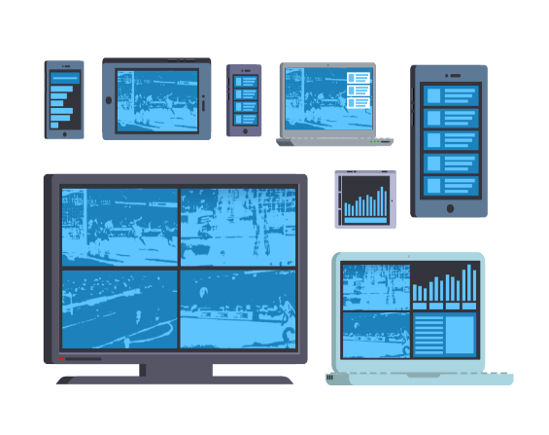
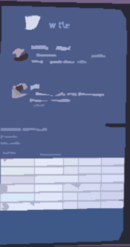


Broadcaster’s signal
Additional related content
Application menu
Cameras provided by IP
Additional related content

Slide 8





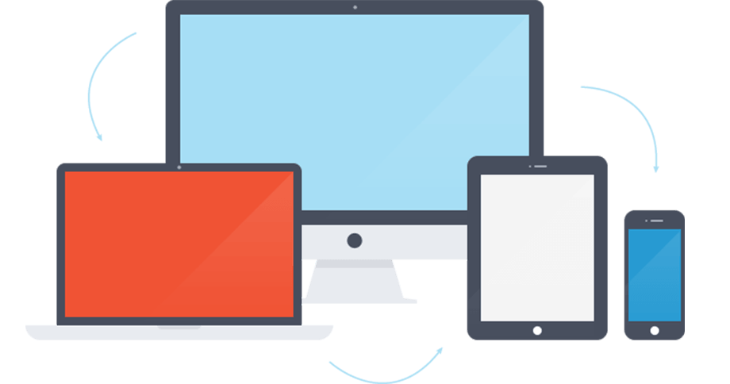

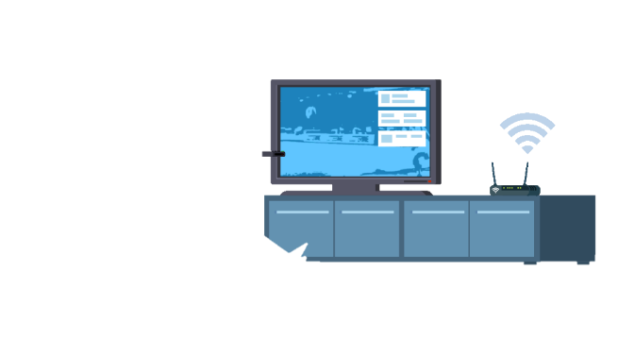



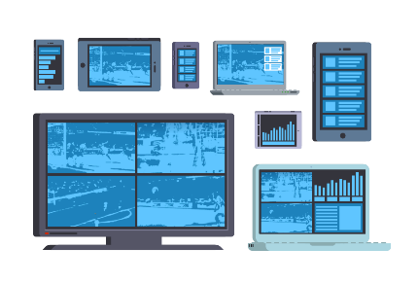
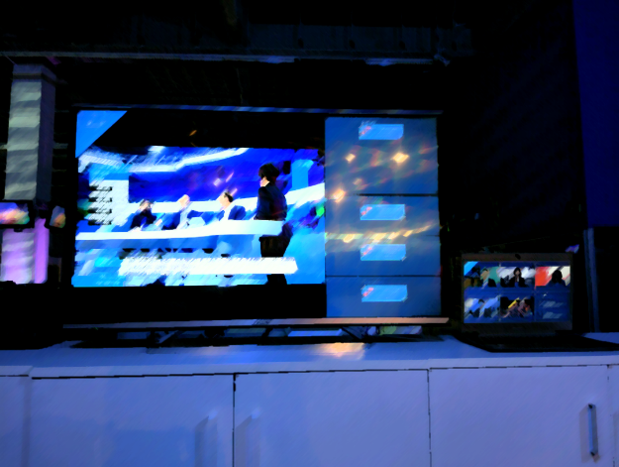


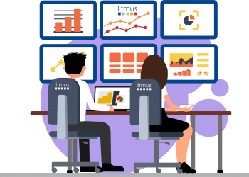

Cont.1
DEPLOYMENT
Cont.2
MULTI DEVICE UI ADAPTATION METHODOLOGY
Cont.3
FIELDS OF APPLICATION
Pilot of a broadcast-Internet Multi-device service
Characterisation of the UI elements
Broadcast
Components
Devices
Layouts
Industry
Learned lessons
Modelling
Extensible
Crisis environments
Usage statistics
Implementation & validation
READY FOR CONTINUOUS ADAPTIVE LEARNING PROCESSES
Extensible

Slide 9



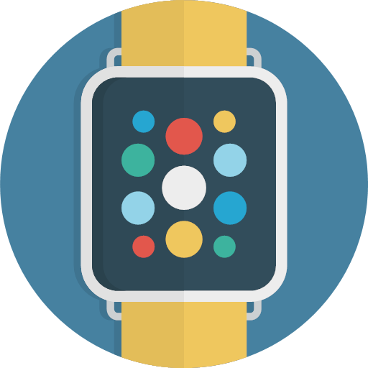
Cont.1
HYBRID BROADCAST-INTERNET PILOT
Cont.2
MULTI DEVICE UI ADAPTATION METHODOLOGY
READY FOR TECHNOLOGICAL UPDATES
ADAPTABLE TO TECHNOLOGICAL UPDATES
Deployment of a broadcast-Internet Multi-device service
Identification of the UI elements
Pub. 2
Pub. 3
Pub. 4
Adaptable
Pub. 1
Cont.3
FIELDS OF APPLICATION
Learned lessons
Modelling, implementation & validation
Extensible
Pub. 6
Pub. 5
READY FOR CONTINUOUS ADAPTIVE LEARNING PROCESSES
Flexible

Slide 10
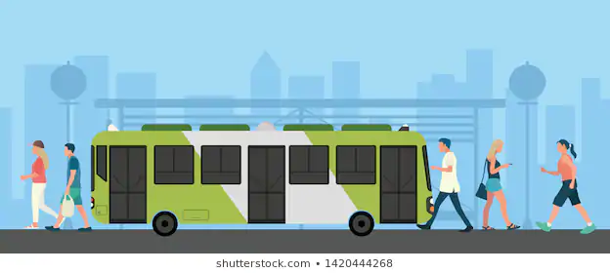




Service migration from one device to another
Interacting with a service from different devices being used simultaneously
Remote synchronised experience sharing between users
Multi-user scenarios mixing personal and shared devices

Slide 11
a) Service migration from one device to another

Slide 12
b) Interacting with a service from different devices being used simultaneously

Slide 13






c) Remote synchronised experience sharing between users

Slide 14
d) Multi-user scenarios mixing personal and shared devices

Slide 15
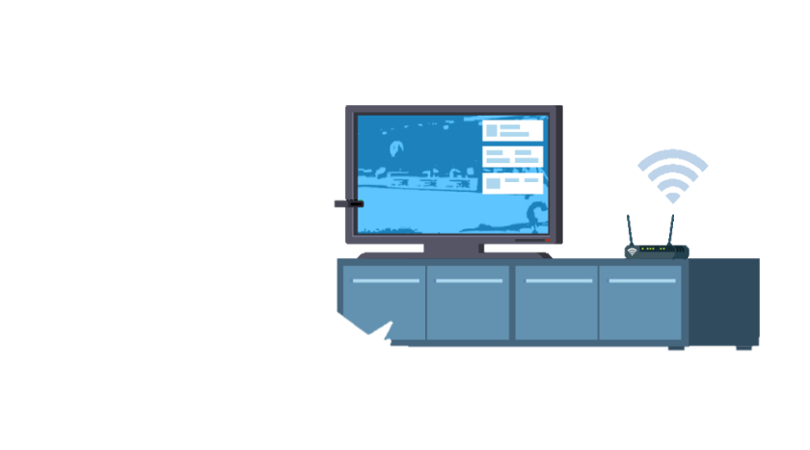




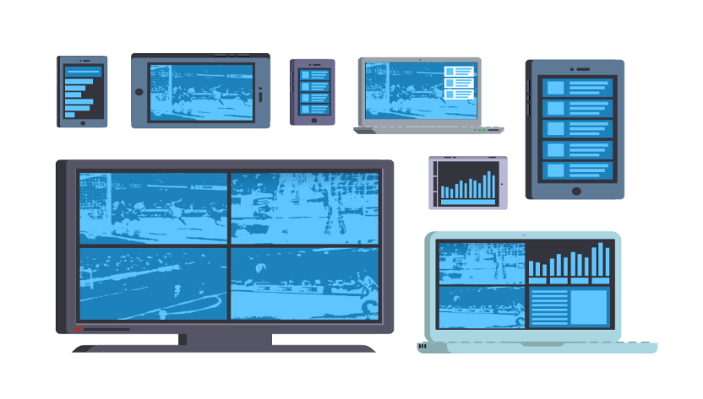











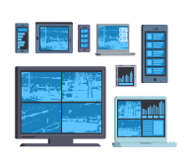
a) Service migration from one device to another
b) Interacting with a service from different devices being used simultaneously
c) Remote synchronised experience sharing between users
d) Multi-user scenarios mixing personal and shared devices

Slide 16
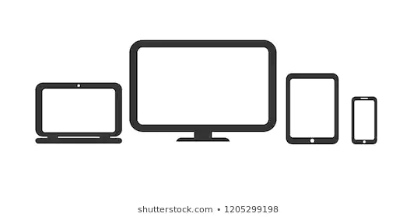
Service migration from one device to another
Broadcaster’s signal
Additional related content
Interacting with a service from different devices being used simultaneously
Remote synchronised experience sharing between users
Application menu
Multi-user scenarios mixing personal and shared devices
Cameras provided by IP
Additional related content

Slide 17
Cont.1
HYBRID BROADCAST-INTERNET PILOT
Cont.2
MULTI DEVICE UI ADAPTATION METHODOLOGY
READY FOR TECHNOLOGICAL UPDATES
ADAPTABLE TO TECHNOLOGICAL UPDATES
Deployment of a broadcast-Internet Multi-device service
Identification of the UI elements
Adaptable
Components
Devices
Layouts
Modelling
Cont.3
FIELDS OF APPLICATION
Learned lessons
Extensible
Usage statistics
Industry
Crisis environments
Implementation & validation
READY FOR CONTINUOUS ADAPTIVE LEARNING PROCESSES
Flexible

Slide 18
Cont.1
DEPLOYMENT
Cont.2
MULTI DEVICE UI ADAPTATION METHODOLOGY
Cont.3
FIELDS OF APPLICATION
Pilot of a broadcast-Internet Multi-device service
Characterisation of the UI elements
Adaptable
Components
Devices
Layouts
Learned lessons
Modelling
Extensible
Industry
Crisis environments
Usage statistics
Implementation & validation
READY FOR CONTINUOUS ADAPTIVE LEARNING PROCESSES
Flexible

Slide 19

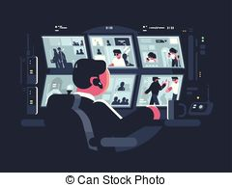
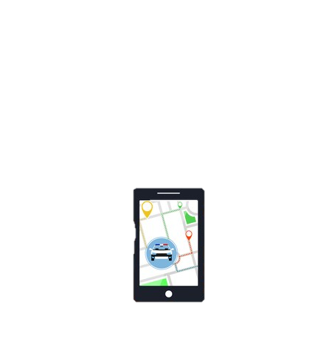


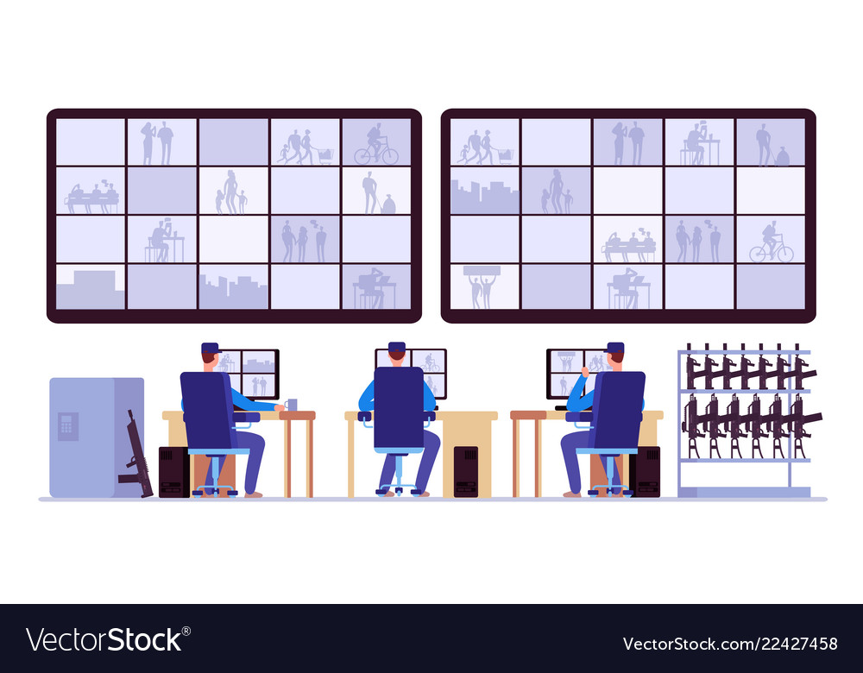
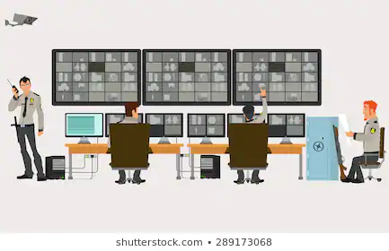
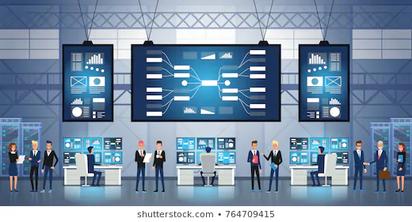
Politicians
Police
Politicians

Slide 20

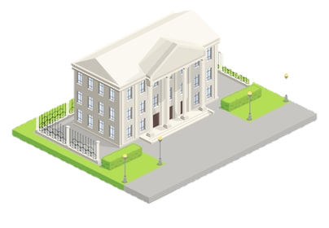
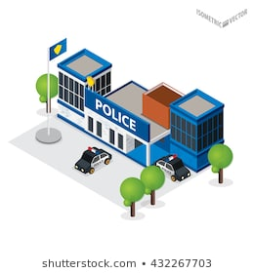
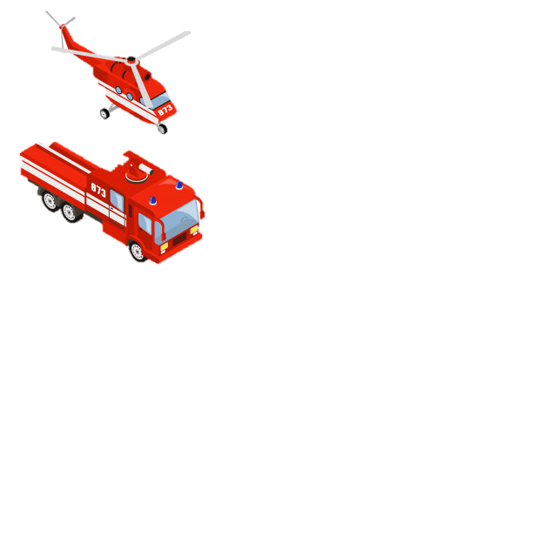
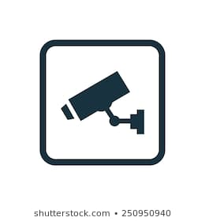
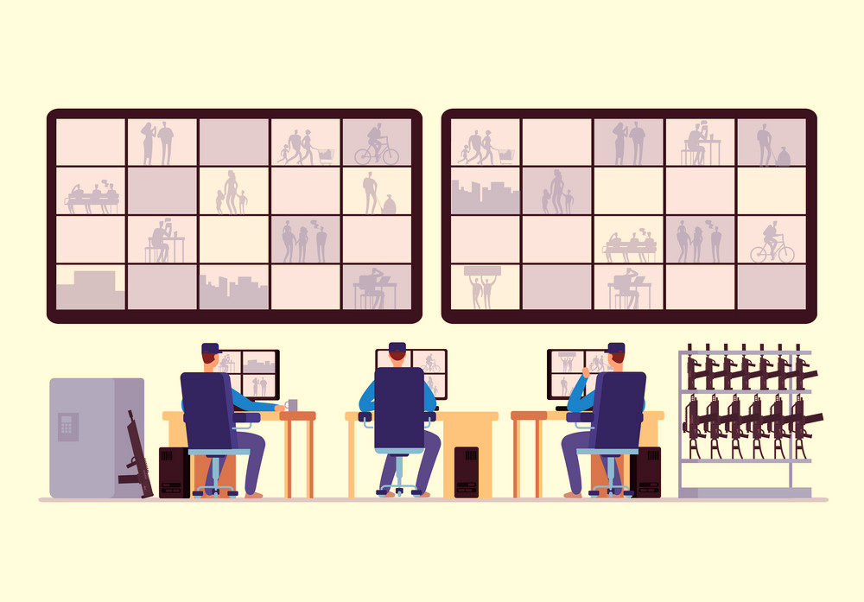

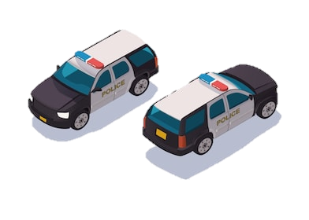

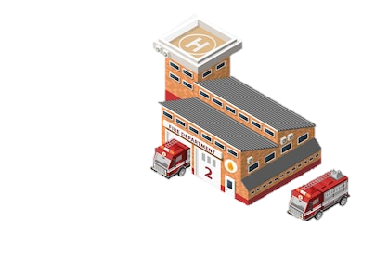



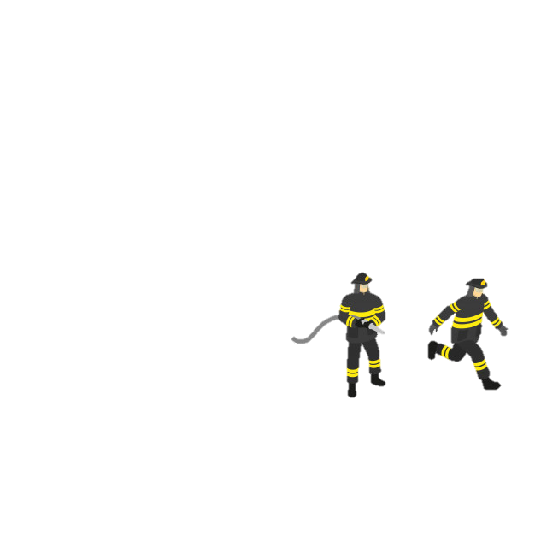
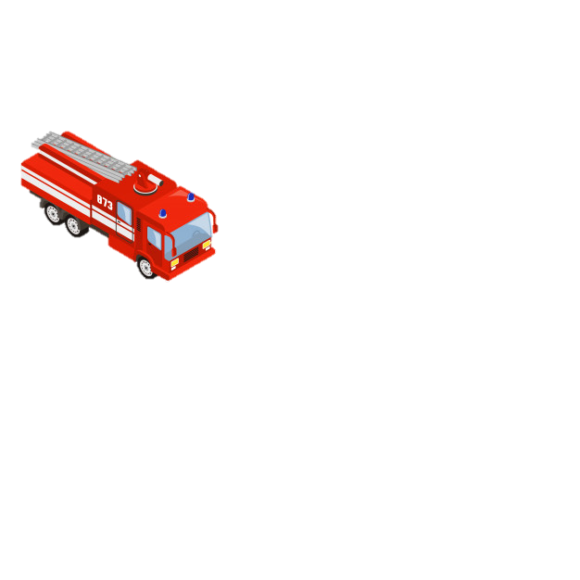
Politicians crisis room
Police crisis room
PMA
Agents in mobility
Emergency services crisis room

Slide 21


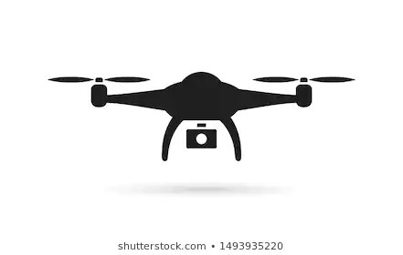
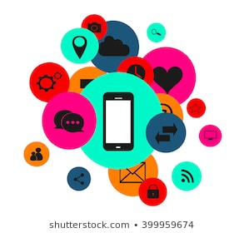

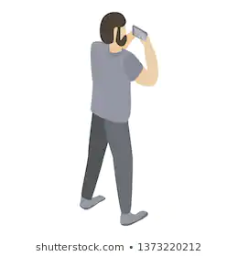
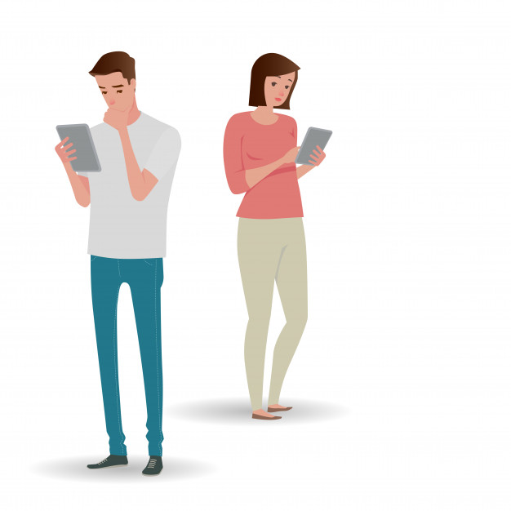


AI to detect relevant events
Adaptable, flexible and easy deployable multi-screen services
Politicians crisis room
Police crisis room
Real-time multiple sources management
AMP
Agents in mobility
Emergency services crisis room
TV signals
Social media

Slide 22









Slide 23



Slide 24


